Slide 1
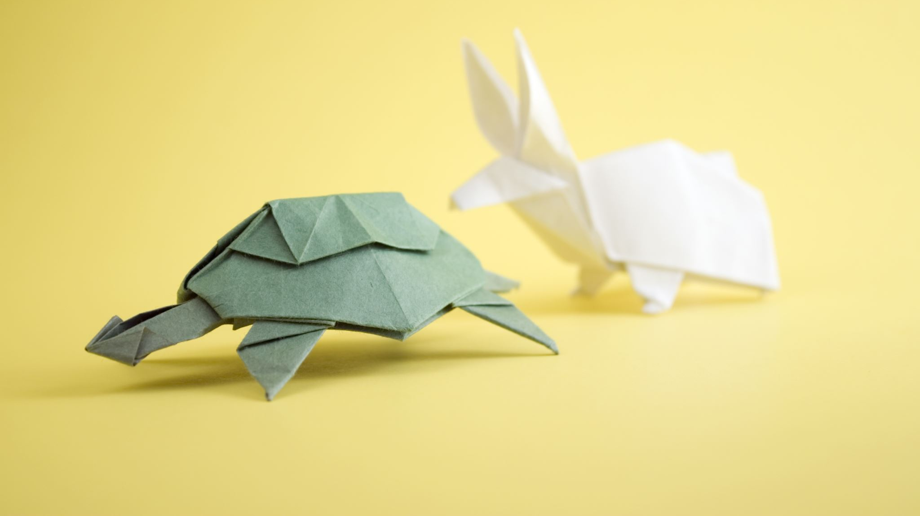
CBIR - Content Based Image Retrieval
Presented by (Group 12):
Aayushi Agarwal, Divya Swaroopa Rani Ogirala, Pavan Kumar Srikanth Naik

Slide 2
Introduction
Objective: To build a system that can excerpt visual content of an image inevitably, like color, shape or texture. Our goal here is to build an image search engine. Given our dataset of photos, we want to make this dataset “search-able” by creating a “more like this” functionality — this will be a “search by example” image search engine.
CBIR can be utilized in numerous applications such as digital libraries, photo sharing sites and crime prevention.

Slide 3
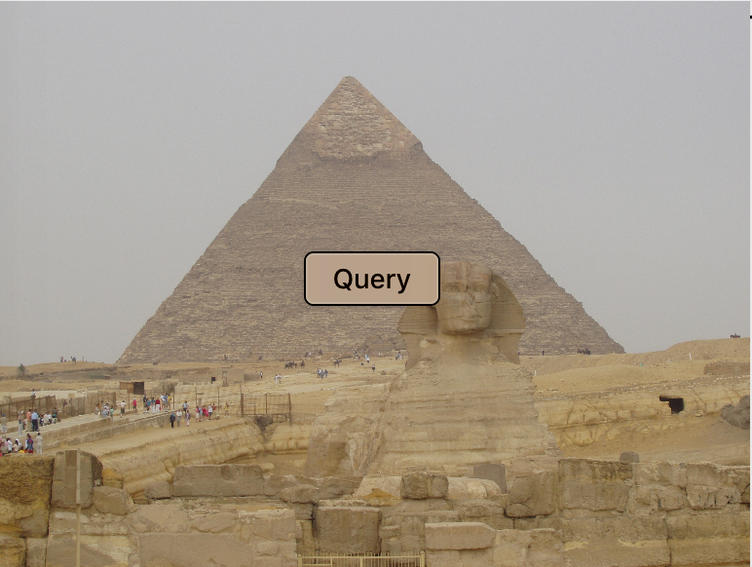
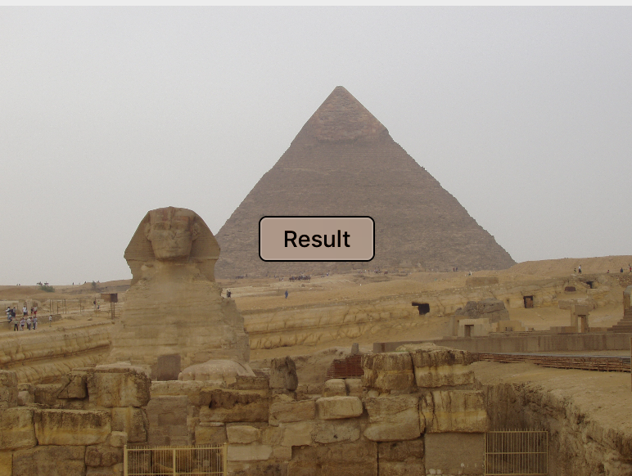
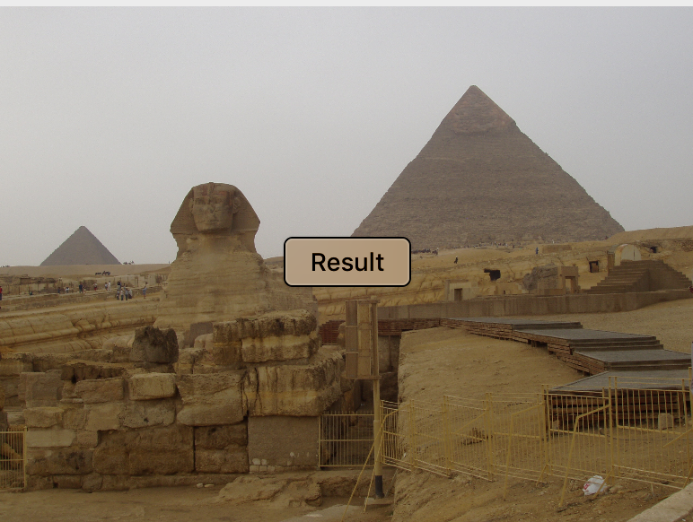
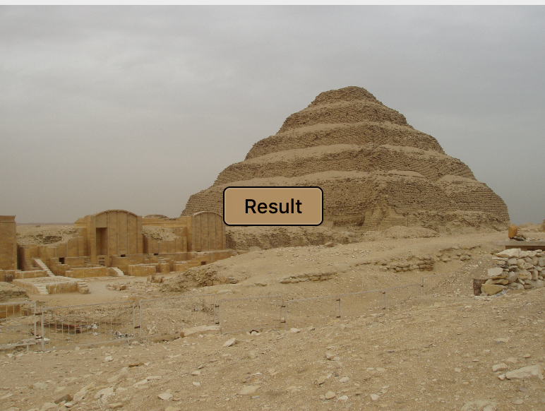
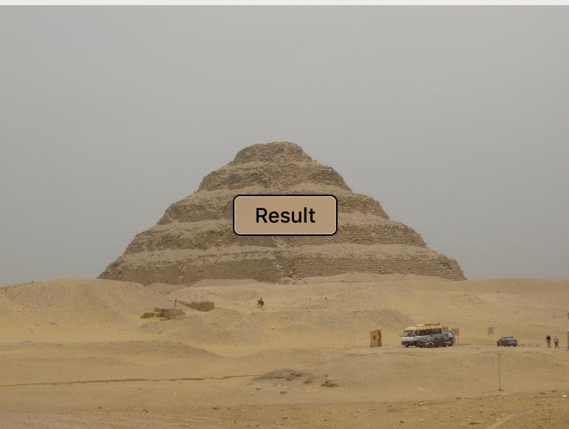
CBIR
{

Slide 4
CBIR system
Defining the Image Descriptor
(color, shape, characterize texture ?)
Index the dataset
(extract features and write to storage)
Define similarity metric
(Euclidean/cosine/chi-squared, etc.)
Search
(user submits query – return relevant images)

Slide 5
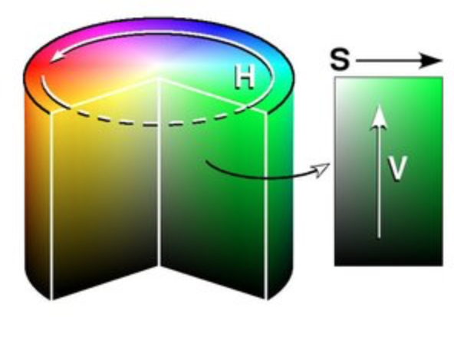
Image Descriptor
3-D color histogram in HSV color space (Hue, Saturation, Value)
Histograms give a (rough) sense of the density of pixel intensities in an image
Estimate probability P of a pixel color C occurring in our image I
HSV color space with 8 bins for the Hue channel, 12 bins for the saturation channel, and 3 bins for the value channel, yielding a total feature vector of dimension 8 x 12 x 3 = 288.

Slide 6
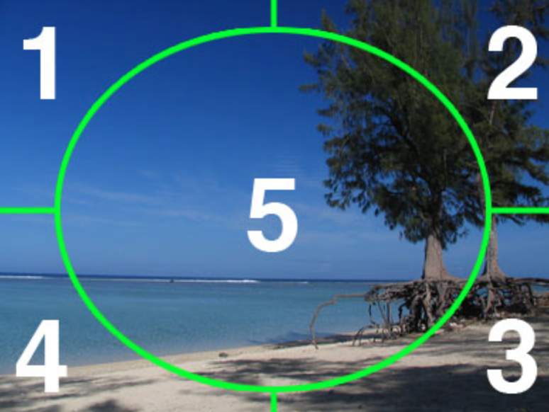
Divide Image into Segments
Where exactly in the image does the blue/brown occurs ?
Remedy - compute color histograms in regions of the image
For our image descriptor, we are going to divide our image into five different regions
The most efficient way of representing each of these segments is to use a mask.
Only pixels in the masked region of the image is used in the histogram calculation.

Slide 7
Feature Extraction
Dataset of Images
Store Features
Extract features from each image

Slide 8
Performing search on CBIR
Database of features
User submits Query Image
Extract Features from Query Image
Compare Query features to Image features in Database
Display results to user
Sort results by relevancy

Slide 9
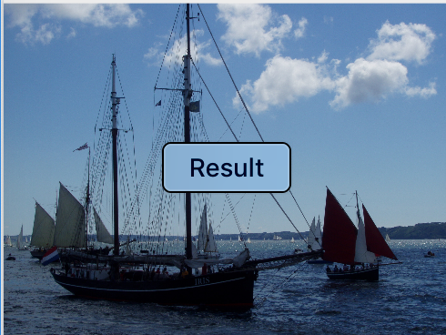
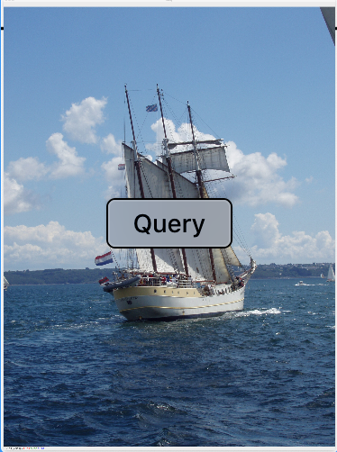
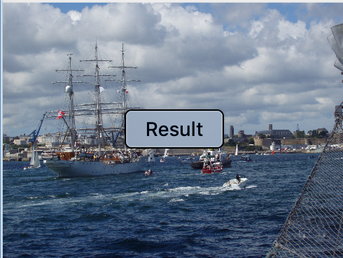
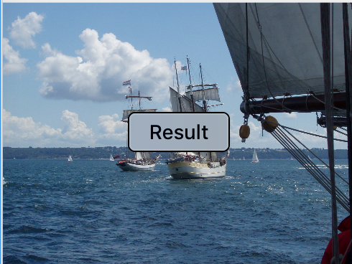
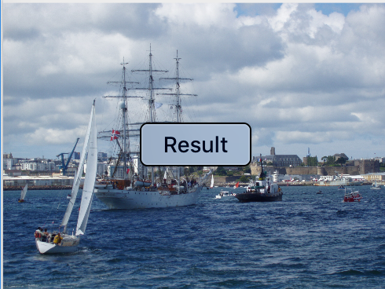
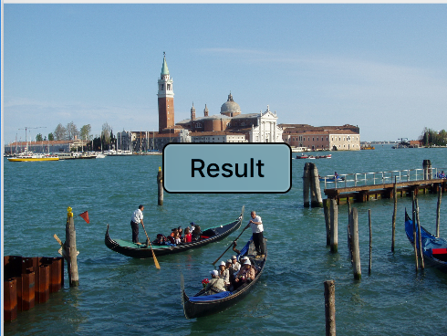

CBIR in Action

Slide 10
Conclusion
We utilized a color histogram to characterize the color distribution of the photos. Then, we indexed our dataset using our color descriptor, extracting color histograms from each of the images in the dataset.
To compare images we utilized the chi-squared distance
Accept a query image - > return relevant results.

Slide 11
Next steps
Use k-means to cluster images and search within clusters that are like the query.
Inverted indexing
Vector Quantization
GUI for a friendly interface; search over a large database.

Slide 12
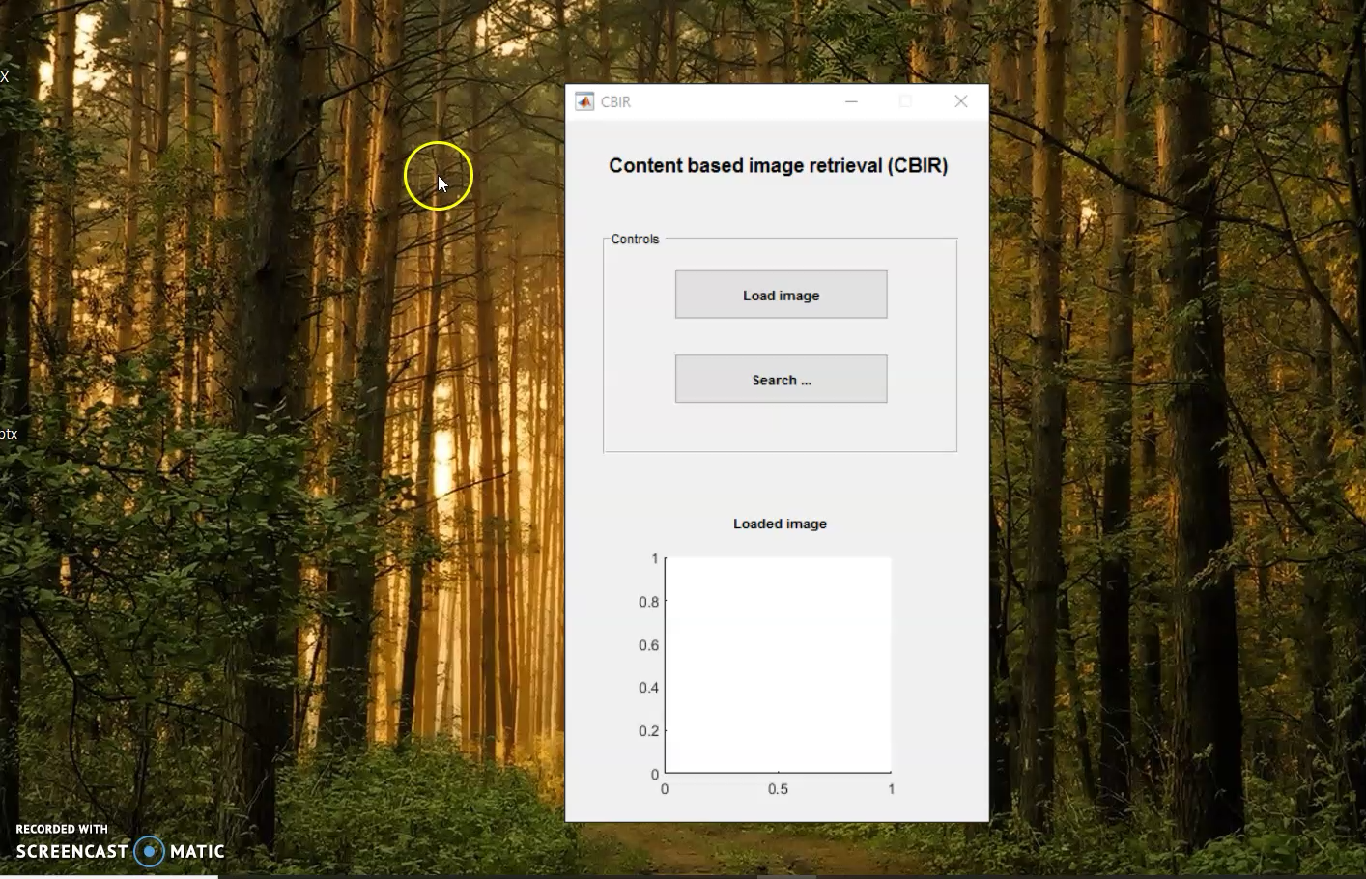

Slide 13
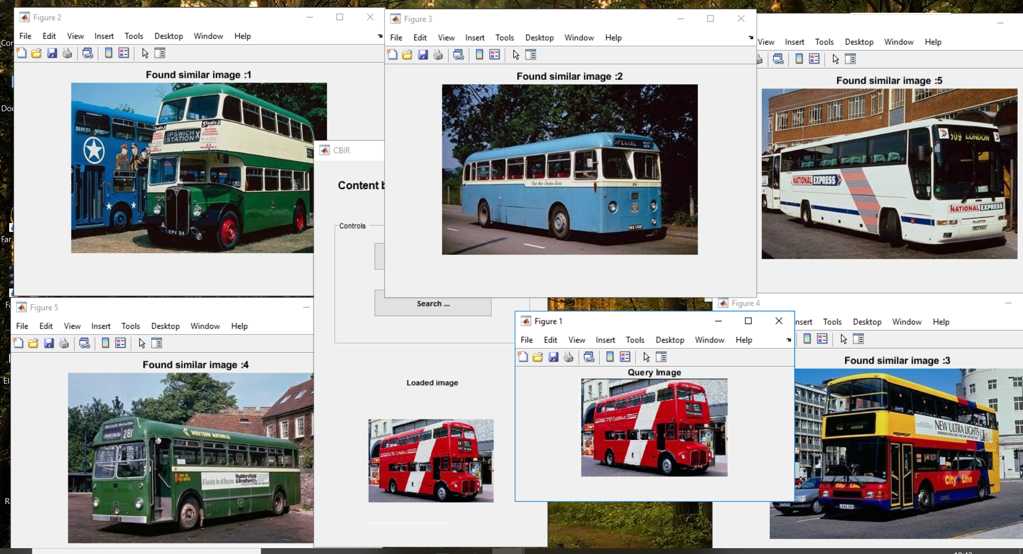
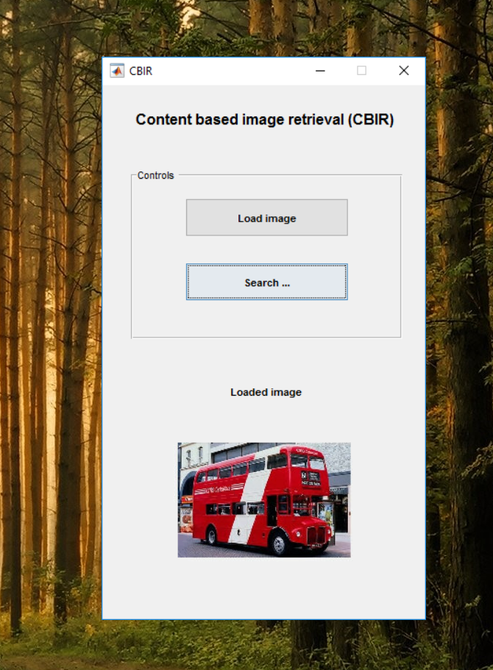
Load and Search Image in GUI

Slide 14
Contribution
Aayushi Agarwal – Image Descriptor, Indexing, Presentation
Pavan Kumar Srikanth Naik – Feature Extractor, Search, Presentation
Divya Swaroopa Rani Ogirala - Similarity metrics, Report, Presentation

Slide 15
Thanks!

